Slide 1
Working with Missing Data
Columbia University Research Methods Workshop
April 14, 2022
Presented by: Maitri Jain

Slide 2
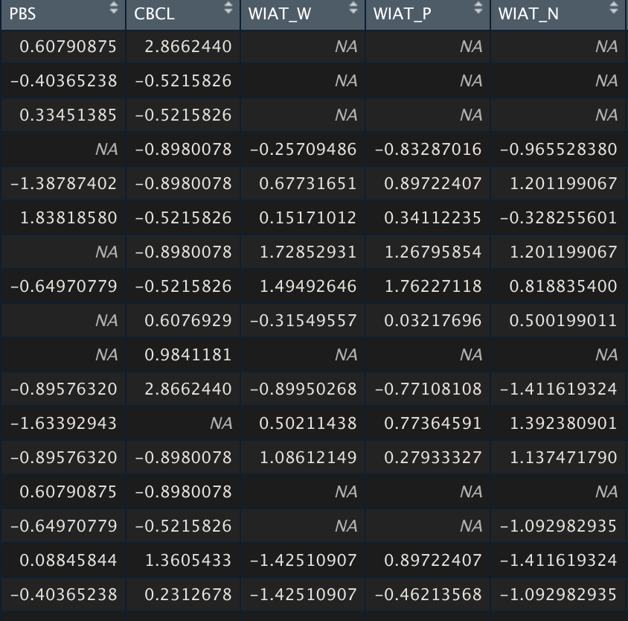
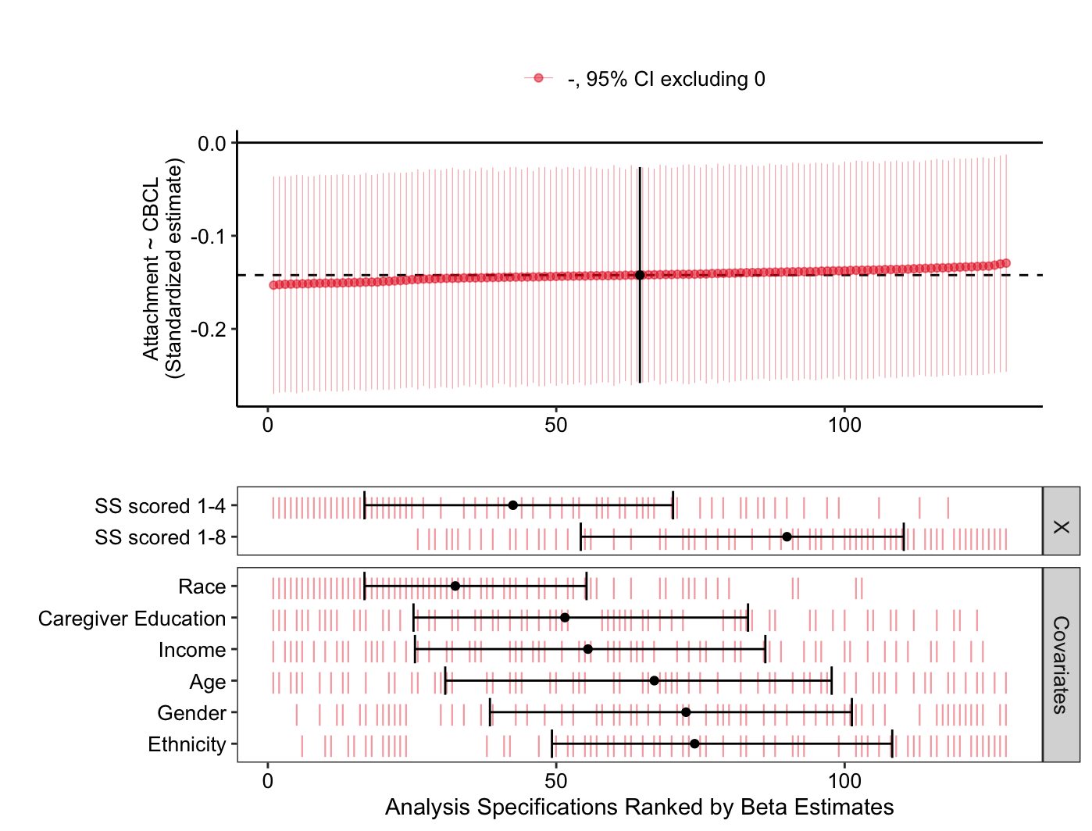
Learning Objectives
I have some missing data points. Should I use multiple imputations?
How do I actually perform multiple imputations?
Now that I have my imputed data sets, how do I analyze them?

Slide 3
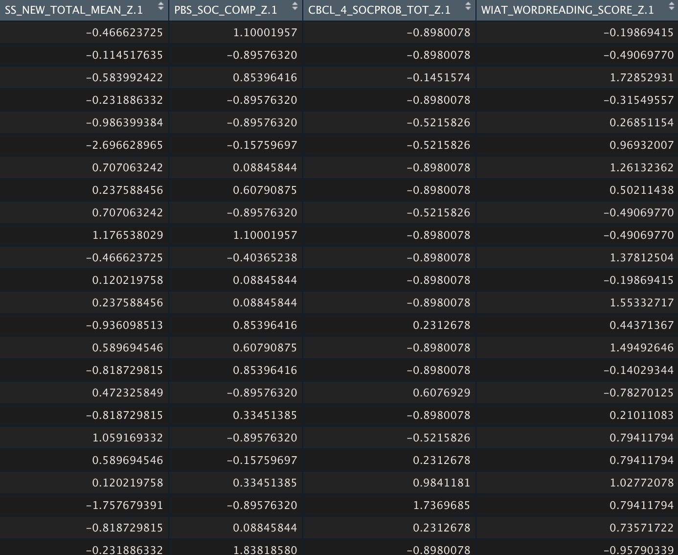
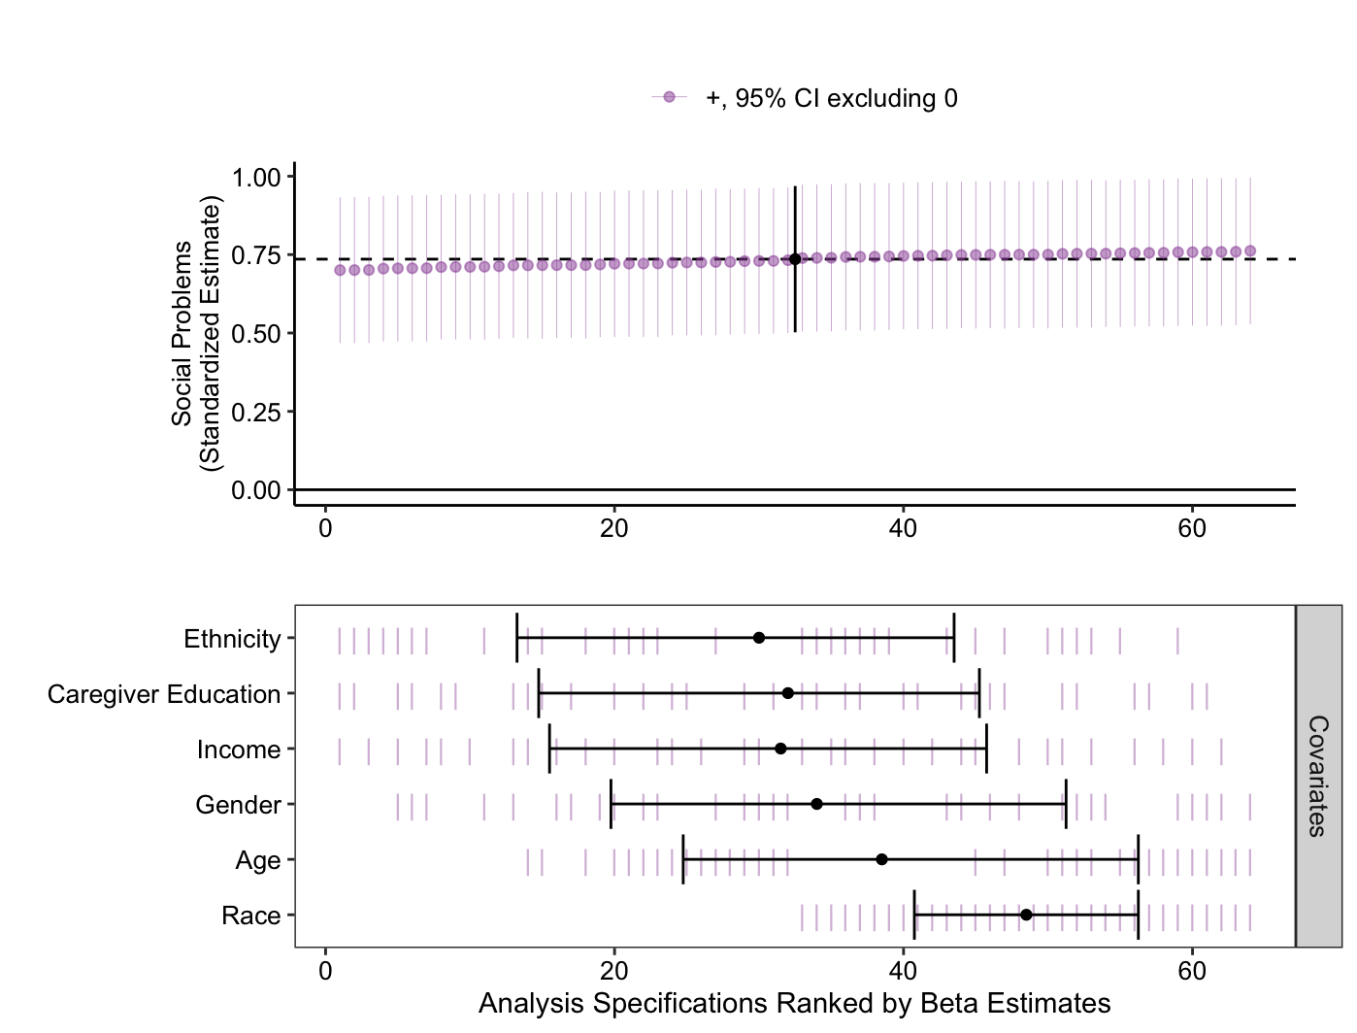
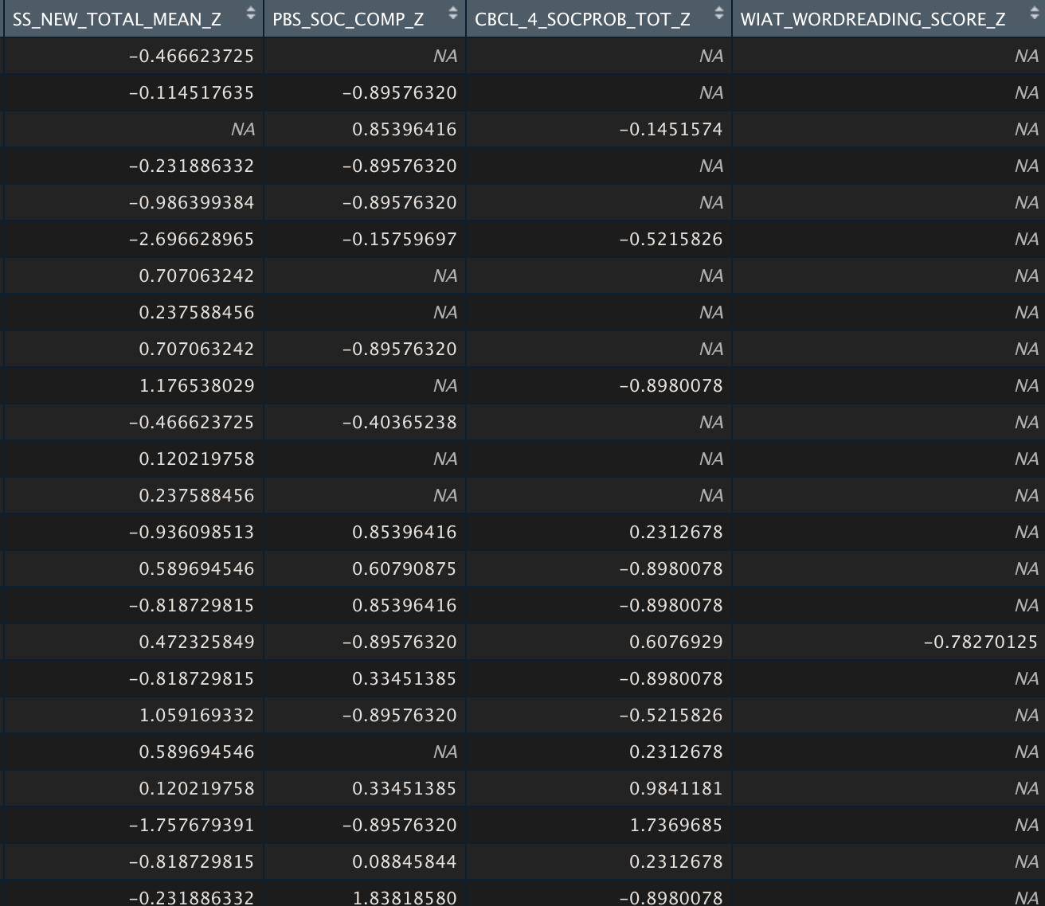

Slide 4
When to conduct multiple imputations?
How to conduct multiple imputations?
How to analyze imputed data?

Slide 5
Missing Data
MCAR
MAR
MNAR
Listwise Deletion (do not recommend)
Pairwise Deletion (do not recommend)
FIML
Multiple Imputations
FIML
Multiple Imputations
Acknowledge the missingness
Do you want to do multiple imputations/FIML?
Getting to know your missing data
What to do about it?
Notes:
10%-40%

Slide 6
Missing Data
MCAR
MAR
MNAR
Listwise Deletion (do not recommend)
Pairwise Deletion (do not recommend)
FIML
Multiple Imputations
FIML
Multiple Imputations
Acknowledge the missingness
Do you want to do multiple imputations/FIML?
Getting to know your missing data
What to do about it?
Notes:
10%-40%

Slide 7
What type of missing data do I have?
Missing completely at random (MCAR)
Equal probability of any item missing.
Missing at random (MAR)
Missingness can be accounted for by other measured variables.
Missing not at random (MNAR)
We cannot account for missing values using measured variables.

Slide 8
Missing Data
MCAR
MAR
MNAR
Listwise Deletion (do not recommend)
Pairwise Deletion (do not recommend)
FIML
Multiple Imputations
FIML
Multiple Imputations
Acknowledge the missingness
Do you want to do multiple imputations/FIML?
Getting to know your missing data
What to do about it?
Notes:
10%-40%

Slide 9
How do I deal with the missing data?
Listwise Deletion
Remove participants with any missing data
Pairwise Deletion
Remove the specific observation which is missing
Full Information Maximum Likelihood (FIML)
Creates one data set using values that maximizes the likelihood function
Multiple Imputation
Create several plausible complete data sets
Notes:
The likelihood function describes the joint probability of the observed data as a function of the parameters of the chosen statistical model.
If stuck – do imputations – can’t hurt

Slide 10
Why imputations?
Imputations reduce bias in your data set.
Imputations increase the power of your analysis.
Imputations have few downsides.
Requires computational resources.
Collins et al., 2001; Graham, 2009; Schafer & Graham, 2002
Notes:
Are we making up data?
If you have strong predictor variables
If you don’t have strong predictors – MNAR
No theoretical downsides

Slide 11
When to conduct multiple imputations?
How to conduct multiple imputations?
How to analyze imputed data?

Slide 12
Which variables to impute?
Can demographics be imputed?
We can impute both IVs and DVs
Transform variables prior to imputations
Allison, 2002; Graham, 2009

Slide 13
What variables to use for imputations?
Whatever will be included in your analytic models need to be included in the imputation model.
Auxiliary variables
Variables not included in the analyses but used for imputations.
Related either to the construct of interest, or,
Related to the missingness
Set decision rules: r>0.4
Err on the side of more inclusiveness
Woods et al., 2021

Slide 14
How to conduct the imputations?
MICE package in R (Chained sequential regression imputations)
Number of imputed data sets (m)
At least as many as the percentage of missing
Fraction of missing information/m < 0.01
Make it reproducible!

Slide 15
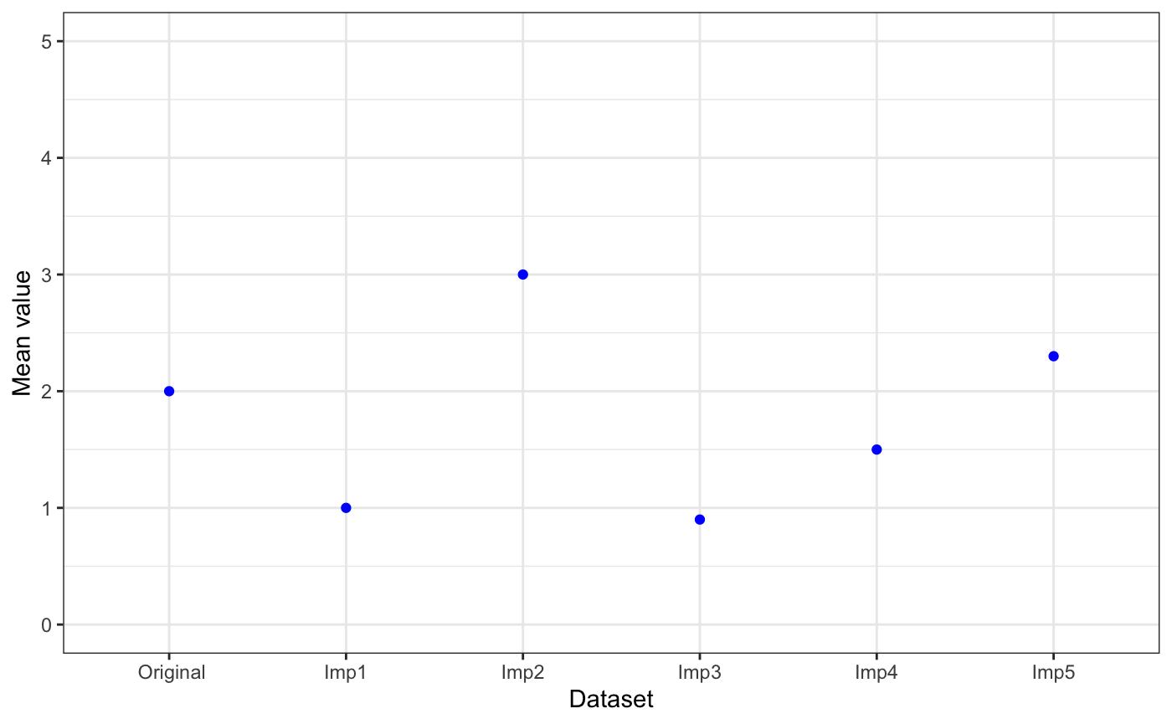
Did I do this correctly?
Imputed data sets should not be exactly same but similar (converge)
Reasonability of imputed values
Compare imputed data to non-imputed data
Means
Variance

Slide 16
When to conduct multiple imputations?
How to conduct multiple imputations?
How to analyze imputed data?

Slide 17
Specification Curves
Parent-child relationship
Respondent
Type of measure
Observation
Child report
Likert scale
Qualitative data
Parent-report

Slide 18
Why specification curves?
Test robustness of results
Reduces bias from researcher preferences
How different decisions influence results
Come up with ‘best practice’ methods

Slide 19
How to perform specification curve analysis?
specr package in R

Slide 20
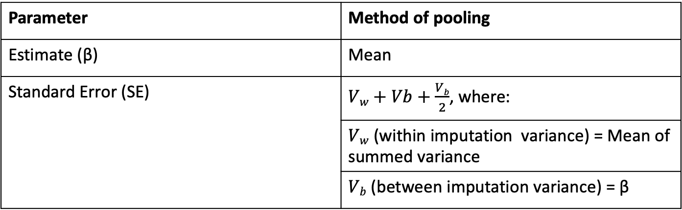
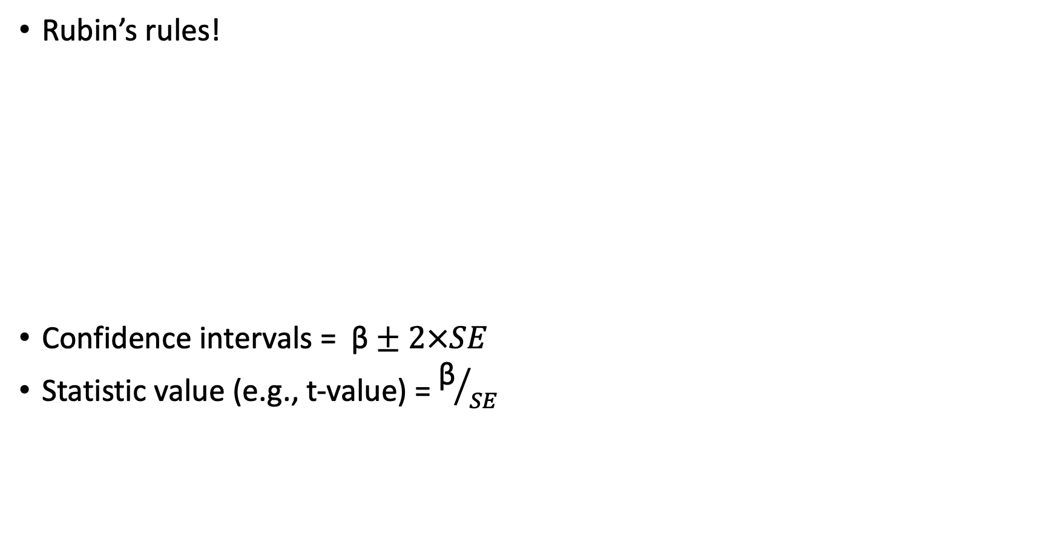
How to combine results across imputations?
Rubin’s rules!
Confidence intervals = $\text{β}±2×SE$
Statistic value (e.g., t-value) = ${\text{β}}/{SE}$
Parameter | Method of pooling
Estimate (β) | Mean
Standard Error (SE) | $Vw+Vb+\frac{Vb}{2}$, where:
 | $Vw$ (within imputation variance) = Mean of summed variance
 | $Vb$ (between imputation variance) = β

Slide 21
TL;DR
I have some missing data points. Should I use multiple imputations?
If you think your data is MAR
How do I actually perform multiple imputations?
MICE package in R
Better to include more auxiliary variables
As many imputations as percentage of missing data
Now that I have my imputed data sets, how do I analyze them?
Analyze each separately
Combine using Rubin’s rules

Slide 22
Missing Data
MCAR
MAR
MNAR
Listwise Deletion (do not recommend)
Pairwise Deletion (do not recommend)
FIML
Multiple Imputations
FIML
Multiple Imputations
Acknowledge the missingness
Do you want to do multiple imputations/FIML?
Which variables to impute
Auxiliary variables
Number of imputed data sets
Type of imputation
Checking results
Analyzing each data set
Combining results
Getting to know your missing data
What to do
How to impute
How to analyze imputed data
Notes:
10%-40%

Slide 23
Resources
GitHub for today’s workshop: https://github.com/Maitrijain99/SCA_with_imputations
Multiple imputations
Woods et al. (2021): https://psyarxiv.com/mdw5r/
MICE (R): https://www.rdocumentation.org/packages/mice/versions/3.14.0/topics/mice
Specification curve analysis
specr (R): https://www.rdocumentation.org/packages/specr/versions/0.2.1
Dani Cosme’s tutorial: https://dcosme.github.io/specification-curves/SCA_tutorial_inferential
Paul Bloom’s tutorial: https://pab2163.github.io/amygdala_mpfc_multiverse/into_the_bayesian_multiverse.html
Rubin's rules: https://bookdown.org/mwheymans/bookmi/rubins-rules.html

Slide 24


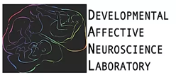

Acknowledgments

